Slide 1
Remote Backup Systems
Presented by:
Amit Kumar Jaiswal(001)
Vikash Kumar Chaurasia(037)

Slide 2
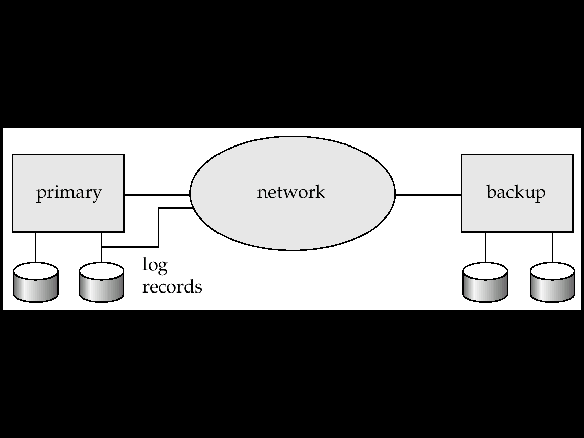
What is Remote Backup Systems
Remote backup systems provide high availability by allowing transaction processing to continue even if the primary site is destroyed.

Slide 3


1. Backup Terminology
Full Backup Level 0
Incremental Backup Level 1
Differential Backup Level 2,3

Slide 4
Detection of Failure
Backup site must detect when primary site has failed
Transfer of Control
To take over control backup site first perform recovery using its copy of the database and all the long records it has received from the primary.

Slide 5
Remote Backup Systems
Time to recover : To reduce delay in takeover, backup site periodically processes the redo log records
Hot Spare : configuration permits very fast takeover
Alternative to remote backup: distributed database with replicated data

Slide 6
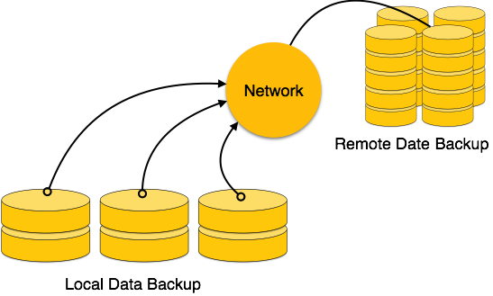
Remote backup provides a sense of security in case the primary location where the database is located gets destroyed. Remote backup can be offline or real-time or online. In case it is offline, it is maintained manually.

Slide 7
Remote Backup Systems
Ensure durability of updates by delaying transaction commit until update is logged at backup
One-safe What is the pain you cure with your solution?
Two-very-safe commit when transaction’s commit log record is written at primary and backup
Two-safe proceed as in two-very-safe if both primary and backup are active.

Slide 8
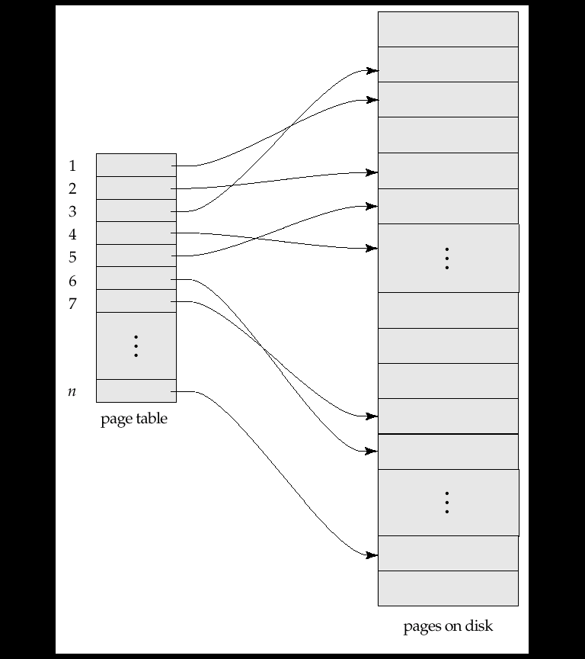
Shadow Paging
Shadow paging is an alternative to log-based recovery
Maintain two page tables during the lifetime of a transaction –the current page table, and the shadow page table

Slide 9
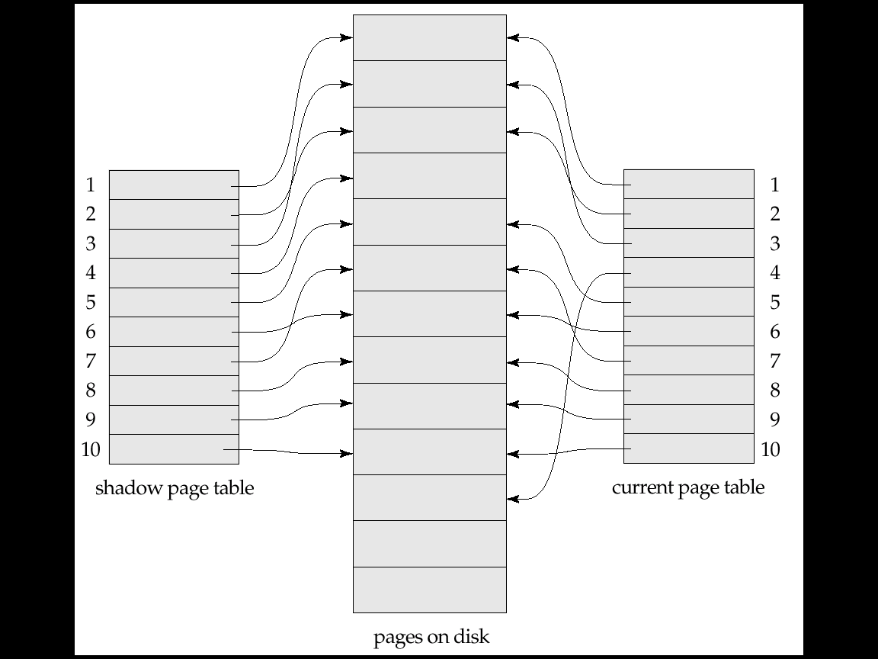
Shadow Paging
To start with, both the page tables are identical. Only current page table is used for data item accesses during execution of the transaction.

Slide 10
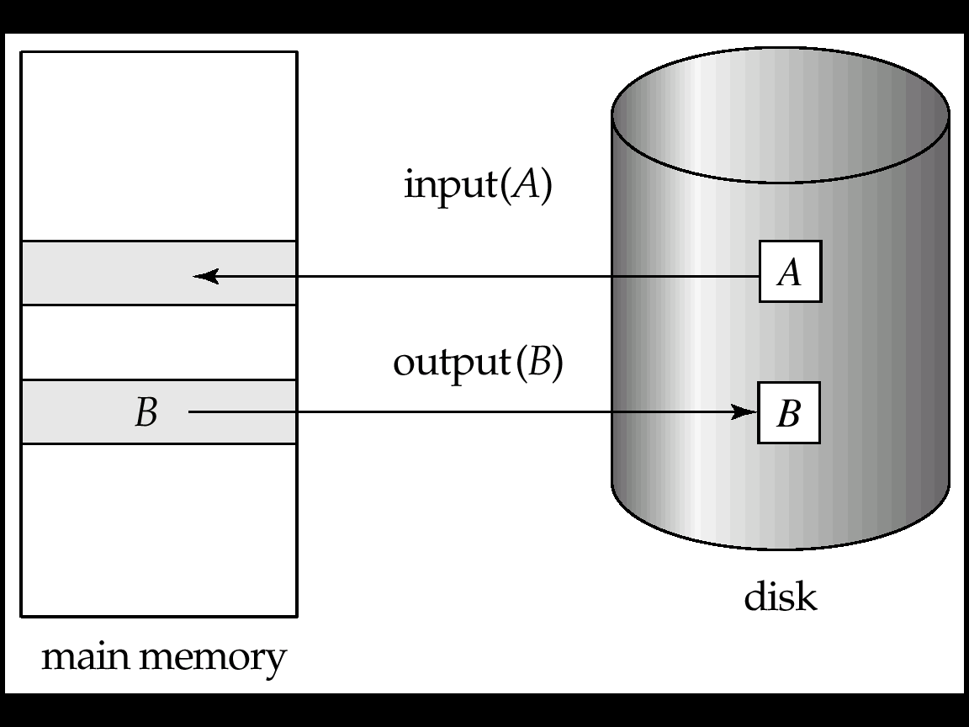
Block storage operations

Slide 11
Shadow Paging
To commit a transaction
Once pointer to shadow page table has been written, transaction is committed
No recovery is needed after a crash
Pages not pointed to from current/shadow page table should be freed

Slide 12
Shadow Paging
Advantage
No overhead of writing log records
Recovery is trivial
Disadvantages
Copying the entire table is expensive
Commit overhead is high
Data gets fragmented
Hard to extend algorithm to allow transactions to run concurrently

Slide 13
Thank You
Feel free to buzz us on Amit: http://twitter.com/AMIT_GKP
Vikash: http://twitter.com/vikash_bltr

